Slide 1
Principles of Compiler Construction
Lecture 6 Syntax Analysis (II)
Lecturer: CHANG HUIYOU
Note that most of these slides were created by:
Prof. Wen-jun LI (School of Software)

Slide 2
问题
给出一个CFG，如何判断一个字符串是否属于它定义的语言？

Slide 3
Recursive-Descent Parsing
boolean A(){
Choose an A-production
for (i=1 to k) {
if ( is a nonterminal && ! ())
return false;
else if ( is a terminal){
if ( equals the current input token t)
get the next token t;
else return false;
}
}
return true;
}

Slide 4
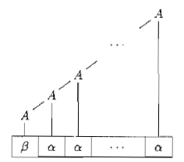
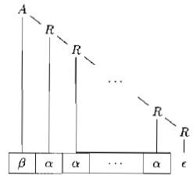


Elimination of Left Recursion

Slide 5

Elimination of Left Recursion
A grammar is left recursive if it has a nonterminal A such that there is a derivation for some string α.

Slide 6
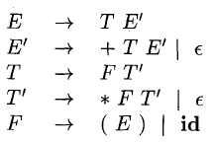

Example

Slide 7

Generally, …

Slide 8

However, …
This procedure eliminates immediate left recursion, but does not eliminate left recursion involving derivations of two or more steps.
Example:

Slide 9
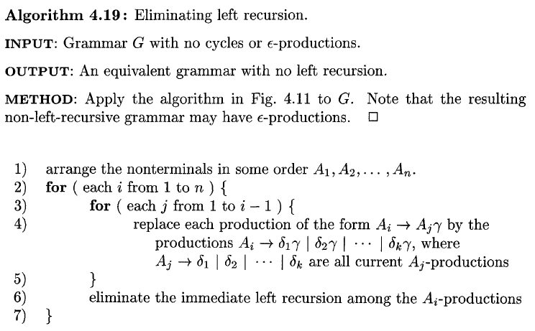
The Algorithm for Elimination of Left Recursion

Slide 10

Example
Dragon, p213

Slide 11
Discussion
Why is the algorithm correct?
What will happen if the input grammar has a cycle?
What will happen if the input grammar has an є-productions?

Slide 12
Challenges
Give an algorithm to convert a grammar into an equivalent grammar that has no є-productions.
Give an algorithm to convert a grammar into an equivalent grammar that has no cycles.
See Exercise 4.4.6 and 4.4.7 (DragonBook p232)

Slide 13
Recursive-Descent Parsing
boolean A(){
Choose an A-production
for (i=1 to k) {
if ( is a nonterminal && ! ())
return false;
else if ( is a terminal){
if ( equals the current input token t)
get the next token t;
else return false;
}
}
return true;
}
Which production should be chosen?
Naive idea: backtracking

Slide 14

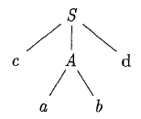
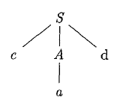
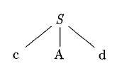
Example
对于字符串cad
cabd != cad, 回溯

Slide 15
More Efficient Approaches
Backtracking is inefficient!
We need more efficient algorithms.

Slide 16
Recursive-Descent Parsing
boolean A(){
Choose an A-production
for (i=1 to k) {
if ( is a nonterminal && ! ())
return false;
else if ( is a terminal){
if ( equals the current input token t)
get the next token t;
else return false;
}
}
return true;
}
It would be fine if there were only one choice!
Lookahead & Left Factoring

Slide 17
Example
对于输入cad

Slide 18

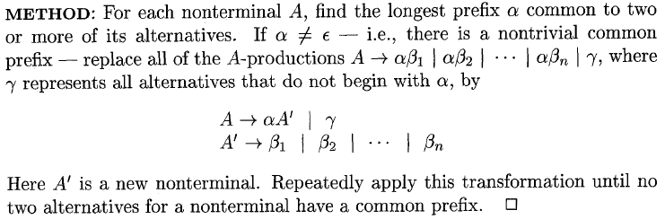
Left Factoring

Slide 19


Example
left factoring

Slide 20
Question
Is left factoring enough for predictive parsing?
No!
E.g.
S→Abc|Bda …
If we only lookahead only one character, we do not know which production should be chosen.

Slide 21

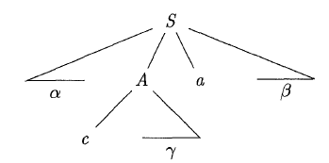
FIRST (α)
Consider two A-productions A→α|β, where FIRST(α) and FIRST(β) are disjoint. We can then choose between these A-productions by looking at the next input symbol a, since a can be in at most one of FIRST(α) and FIRST(β), not both.

Slide 22
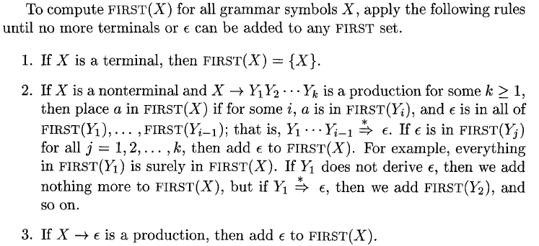
Computing FIRST(X)

Slide 23
Example
Compute the FIRST(X) for each nonterminal X.

Slide 24

FOLLOW(A)
S→aA|є, if the next input symbol is not ‘a’, then will will choose S→ є; otherwise both productions can be chosen.
if A can be the rightmost symbol in some sentential
form, then $ is in FOLLOW(A).

Slide 25
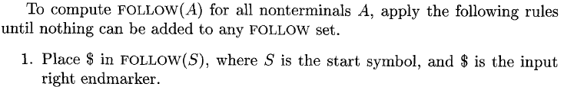
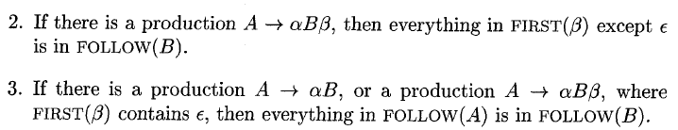
Computing FOLLOW(A)

Slide 26
Practice
Compute the FOLLOW(X) for each nonterminal X.

Slide 27
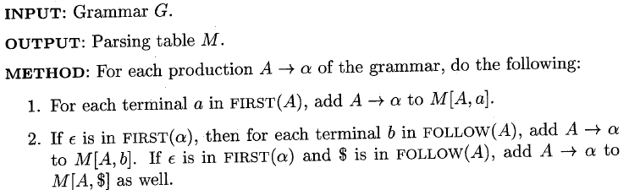

Construction of a Predictive Parsing Table

Slide 28
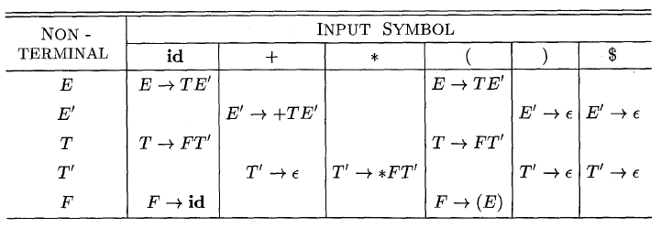
Predictive Parsing Table

Slide 29
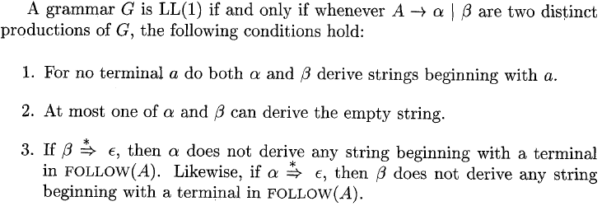
LL(1) Grammar
第一个L：输入字符串从左边开始扫描
第二个L：得到的推导是最左推导
(1)：向前看1个输入符号（或单词）

Slide 30

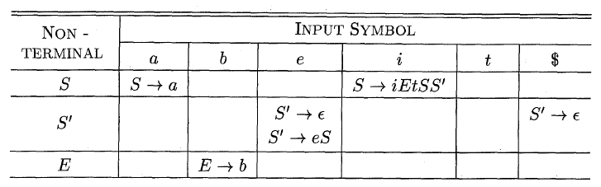
Example
Since M[S’, e] contains more than one production, the grammar is not LL(1).

Slide 31
作业
Week07.pdf

Slide 32
Implementing the Parser
Two ways:
Recursive
Non-recursive， table-driven

Slide 33
Coding for Recursive Predictive Parser
A→aBb
boolean A(){
return (match(‘a’) && B() && match(‘b’));
}
boolean match(Token t){
if (lookahead == t){
lookahead = lexer.nextToken();
return true;
else return false;
}

Slide 34
Coding for Recursive Predictive Parser
A→aBb|bAC
boolean A(){
if (lookahead == ‘a’)
return (match(‘a’) && B() && match(‘b’));
else if (lookahead == ‘b’)
return (match(‘b’) && A() && C());
else return false;
}

Slide 35
Coding for Recursive Predictive Parser
A→aBb|bAC|Da
boolean A(){
if (lookahead == ‘a’)
return (match(‘a’) && B() && match(‘b’));
else if (lookahead == ‘b’)
return (match(‘b’) && A() && C());
else if (lookahead in FIRST(D))
return (D() && match(a));
else return false;
}

Slide 36
Coding for Recursive Predictive Parser
A→aBb|bAC|є
boolean A(){
if (lookahead == ‘a’)
return (match(‘a’) && B() && match(‘b’));
else if (lookahead == ‘b’)
return (match(‘b’) && A() && C());
else if (lookahead in FOLLOW (A))
return true;
else return false;
}

Slide 37
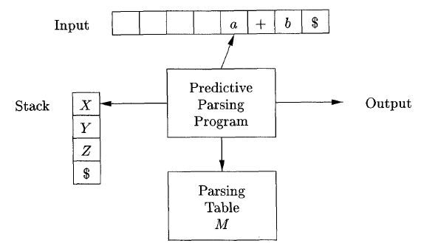
Model of a Table-Driven Predictive Parser

Slide 38
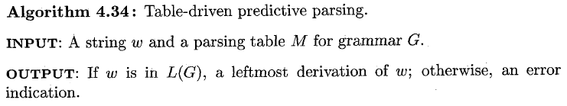
Table-Driven Predictive Parsing

Slide 39
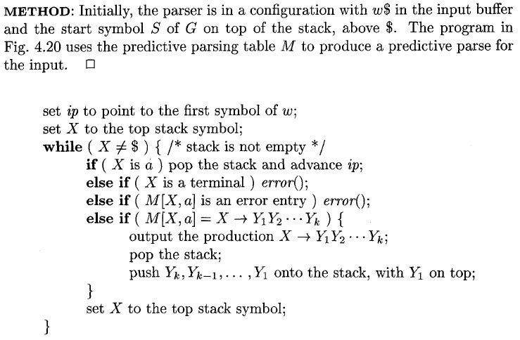
Table-Driven Predictive Parsing
the current input symbol
if (a != ‘$’) error();

Slide 40
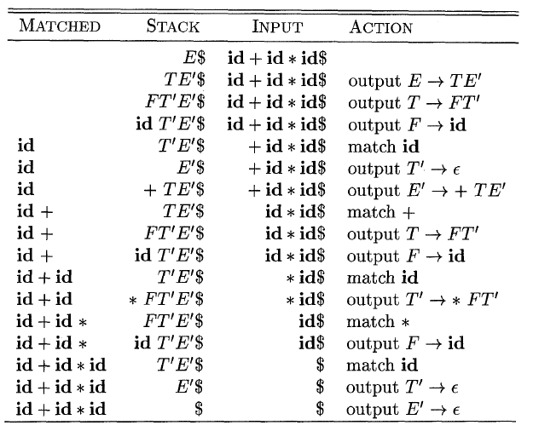
Example

